Slide 1


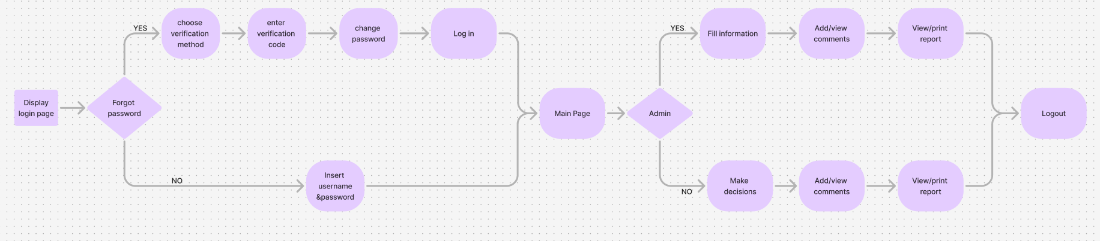

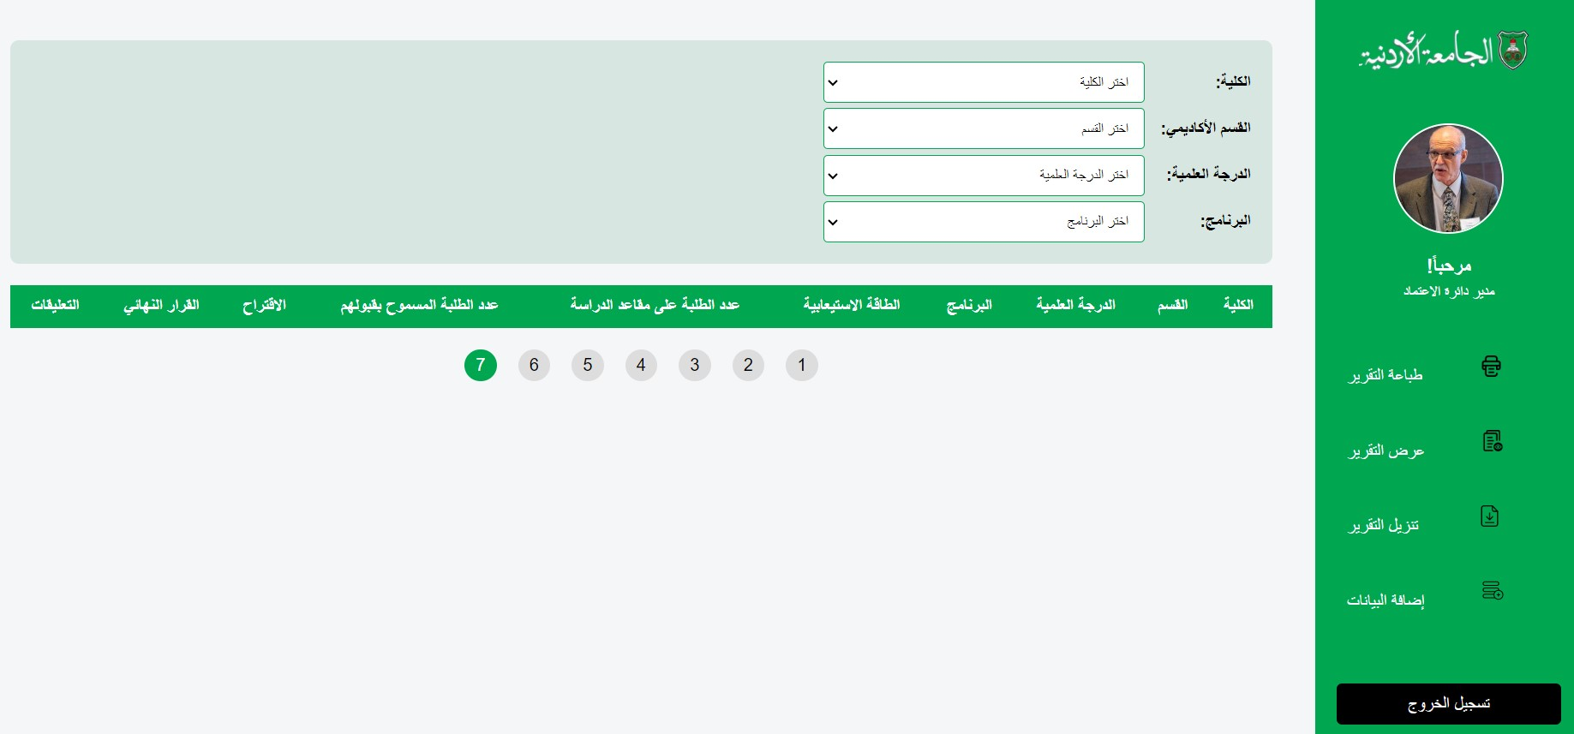
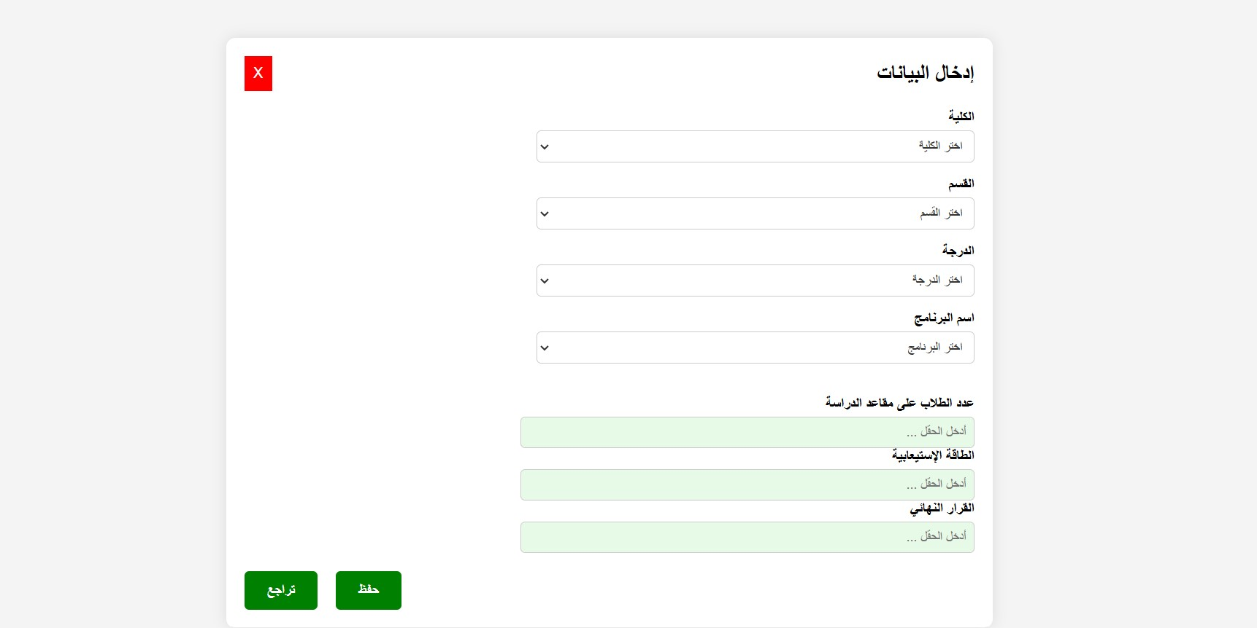
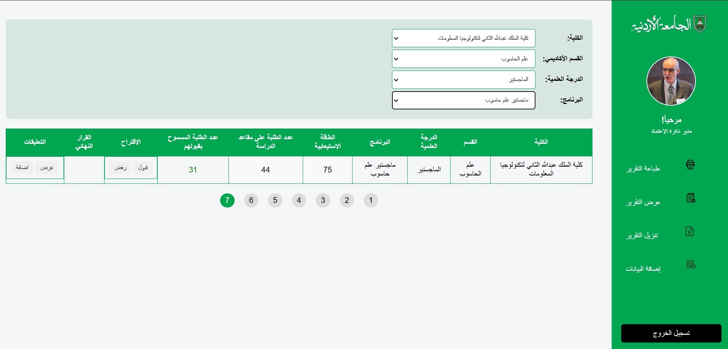
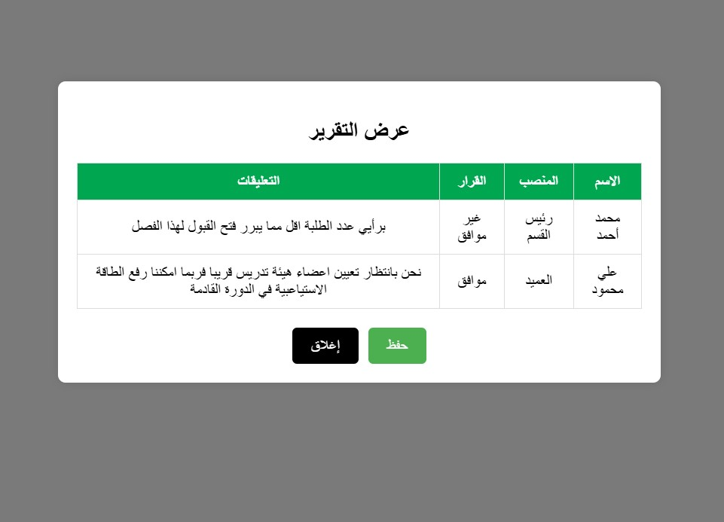
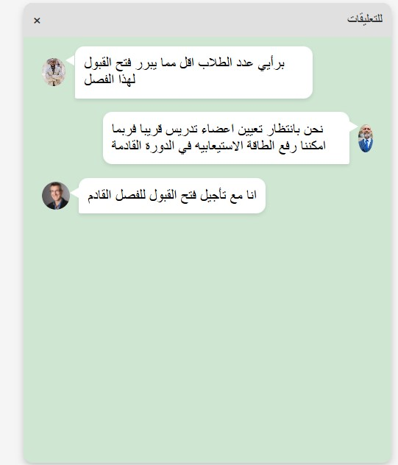
System for Studying and Providing Opinions on the Number of Students Admitted each Semester to Academic Programs at the University of Jordan
Done By:
Jana Ghadieh, Leen Almasarweh, Dana Abu Alruz, Eithar AlSalameh,
Rahaf Elayyan, and Khadeejeh Bader
Supervised By:
Dr. Mohammad A. M. Abushariah
ABSTRACT
Efficient management of student admissions is crucial for maintaining the quality and capacity of academic programs. It is also essential to help academic institutes avoid fines imposed by accreditation bodies . However, the existing manual processes at the University of Jordan for collecting and analyzing feedback on the number of students admitted are time-consuming, prone to errors, and inefficient.
Our system works on developing a user-friendly interface that automates workflows, reduces errors, and accelerates decision-making. It converts manual operations into streamlined digital processes
The system enhances collaboration, optimizes decision-making, and significantly improves the efficiency of managing student admissions in alignment with program capacities.
SYSTEM FLOW CHART
Figure 1: System Flow Chart
GRAPHICAL USER INTERFACES (GUI)
Figure 2: Log in Figure 3: Main interface
Figure 4: Data form Figure 5: Selection
Figure 6: Report Figure 7 : Opinion
INTRODUCTION
Managing student admissions effectively is crucial for universities to balance academic quality and resource utilization. The University of Jordan currently relies on manual methods to collect and analyze feedback from stakeholders, such as department heads and deans, regarding student admissions. These outdated processes lead to delays, errors, and financial penalties due to over-admissions or exceeding program capacities.
Our project, "System for Studying and Providing Opinions on the Number of Students Admitted Each Semester to Academic Programs at the University of Jordan," develops an intuitive and efficient web-based system. This system automates workflows, enhances collaboration, and provides stakeholders with accurate data and tools to make informed decisions, ultimately improving the admissions process.
PROBLEM STATEMENT
The University of Jordan faces significant challenges in its student admission process due to the use of manual procedures for gathering feedback, which are inefficient and prone to errors. These challenges include :
Financial penalties due to exceeding program capacities or increasing application fees.
Lack of an intuitive system, leading to frustration among users.
OVERALL SOLUTION APPROACH
We propose a web-based system designed to:
Automate the collection and analysis of feedback, reducing the reliance on manual methods and minimizing errors in decision-making.
It provides stakeholders with accurate numbers for the capacity allowed as well as the number of students currently studying in each program, it also automatically calculates the maximum number of students allowed without exceeding capacity enabling informed decisions.
The system ensures an intuitive and user-friendly interface, making it accessible to all stakeholders with minimal training required.
The system ensures a transparent and efficient decision process.
GUI USABILITY EVALUATION
Heuristic Evaluation is used to evaluate the usability of the GUI of the system in order to identify the usability problems, whereby 3 expert evaluators were selected.
Cooperative Evaluation is used by the targeted users (We have tested the application on many individuals ranging from university academic to people working in academia related administration in Jordanian institutes
RESULTS AND CONCLUSIONS
Heuristic Evaluation (3 evaluators believe that there is no serious and catastrophic usability problems in the system .
Cooperative Evaluation (Questionnaire was distributed to the users after they used the system, which mainly questions their experience in the system. On average, the system was rated as 4 out of 5 indicating that the system is well received by the users and they didn’t experience any major usability problems.
Therefore, this system has passed through relevant tests and is recommended to be used and integrated into the University system .
PROJECT AIM AND OBJECTIVES
The project aims to design and implement an efficient system that improves decision-making in the admissions process and reduces errors.
Simplify feedback collection among stakeholders.
Minimize decision-making time and associated errors.
Enhance user experience with an intuitive, HCI-driven interface.
Ensure security and compliance with university policies and data privacy regulations.

